Slide 1
What is Structural Engineering?
Notes:
This presentation will describe the major roles of structural engineers, how they fit within the construction industry, what structural engineers typically work with, and how students can prepare for the engineering field.
During this introduction slide, the speaker should introduce himself or herself with name, title, company they work for, etc. The speaker should introduce the plan for the presentation: PowerPoint presentation and then a group game.
The speaker may want to open the presentation by asking the students this question,' What is structural engineering?’ and allow the students to offer their ideas. If no responses are offered, try prompting the students with questions like, ‘What is this a picture of?’ (The Leonard P. Zakim Bridge) ‘So who do you think designed the Zakim Bridge?’ (A structural engineer) ‘What about all those other towers, roads, and other buildings in the background? A structural engineer designed all of those, too. So let’s look at more details about engineering and structural engineering in particular.’

Slide 2
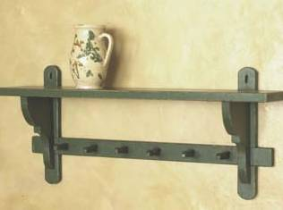
What is engineering?
“The art or science of making practical application of the knowledge of pure sciences, such as physics or chemistry, as in the construction of engines, bridges, buildings, etc.”
Daily engineering-type activities that you perform without knowing it is engineering:
Notes:
Purpose: To summarize quickly and in general terms what engineering is
The speaker is to explain to the audience what engineering is by giving some examples of simple, daily activities that people perform even without knowing that they are considered engineering. For example, building a bookshelf, poking two holes on the lid of can for easy pouring, or swinging a bat effectively, are applications of science and laws of mechanics to daily activities. This slide is to engage the audience into thinking that engineering is all around us, and it does not always have to be buildings, cars, or computers.
____________________
Verbatim Format
Engineering is the application of science, such as chemistry, biology, and physics, to real life problems.
You probably have done some engineering design on a daily basis without knowing that you have done engineering. For example you probably have designed and installed a bookshelf before. What kind of engineering did it involve? Did you have to use mathematics to help you measure the wood planks before you cut them? If you have to cut out a triangular piece of wood, did you use equations (such as the Pythagorean Theorem) to measure the lengths of the different sides? How did you make sure that the shelf would be level? Did you think about what would go on the shelf? Did you pick out a certain material for a specific reason? How do you attach the shelf to the wall? Where did you get the tools and materials from?
These are all similar questions engineers face when they design almost anything.
____________________
Outline Format
I. Define Engineering
II. Examples of daily activities that are considered engineering

Slide 3
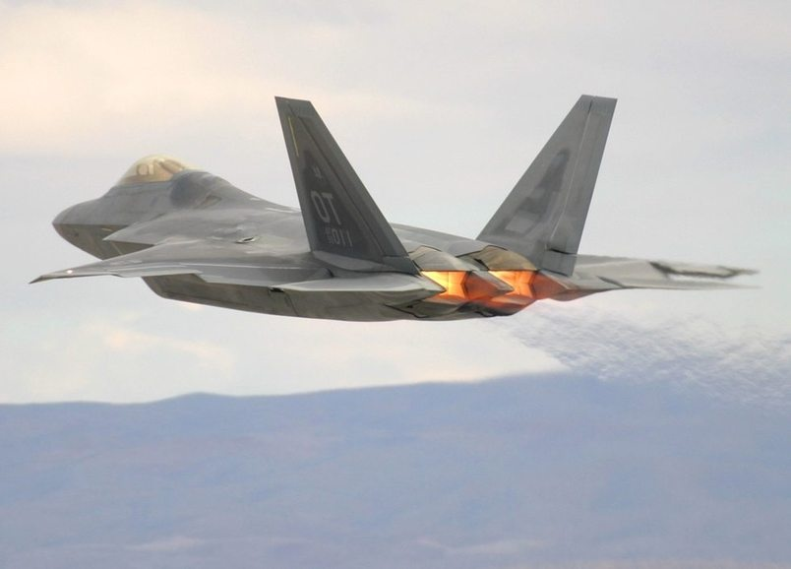
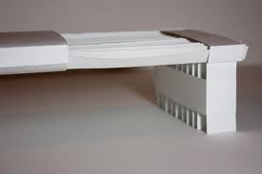
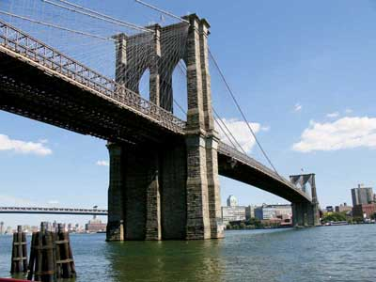
Keep it Simple, Scale It Up
Notes:
Purpose: To summarize the major different basic everyday problem solving and professional engineering activities in different fields, scaling up type and quantity of simple solutions.
In this slide the speaker is to focus on the use of simple concepts that come from simple problem solving. From there the speaker is to show how professional engineers really take these simple solutions and scale them up. Express to your audience that an engineer identifies all the simple things going on, and scales them up as the complexity increases. Build on the previous slide with creating a bookshelf. Two examples are shown. First is a paper airplane. Second is a model bridge.
____________________
Verbatim Format
Many people think you have to be a math genius or happy with number crunching to be a professional engineer. As it turns out, that’s not actually true. What engineers do is take the same simple concepts that we just talked about and scale them up for larger objects. For instance, with paper airplanes we figure out what size to make the wings so that the plane can stay up in the air and how hard to throw it so it can travel far. The same goes with jet planes, engineers design the size and shape of the wings so that it can stay in the air and give it powerful engines so it can travel far and fast.
The same can be said with large structures like bridges. Can you think of the things you would watch out for when building a paper bridge? We think about the size, shape, and the strength of the paper. We also think about how we connect the pieces. When we build real bridges we think of these same things but we just scale them up both in size and quantity.
____________________
Outline Format
Simple Engineering Solutions
Scale Up Simple Solutions
Paper Airplane Example
Paper Bridge Example

Slide 4
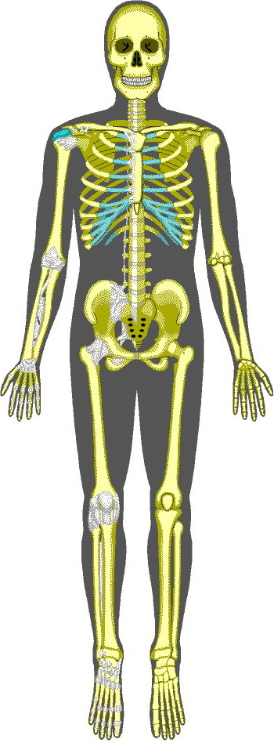
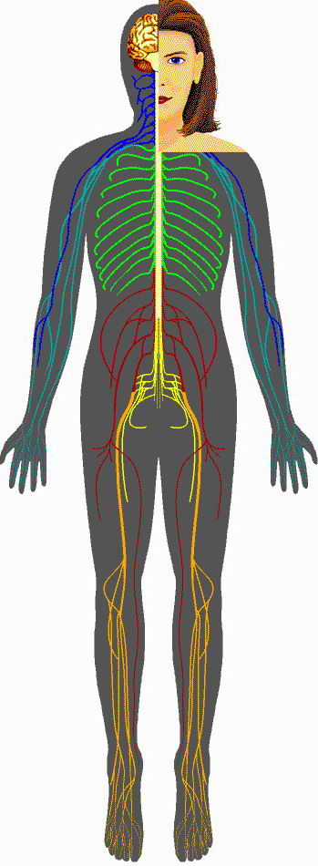
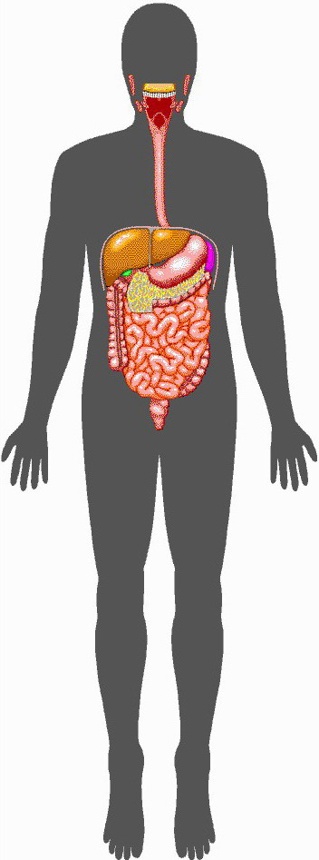
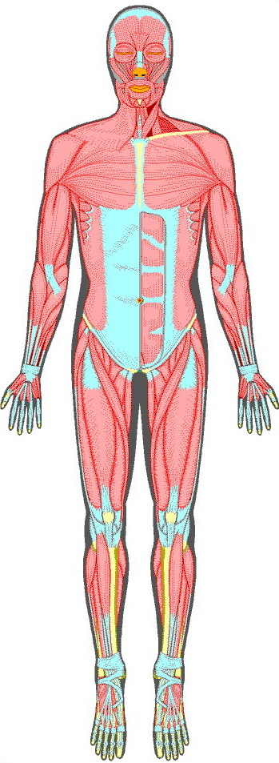
Human Body Comparison
Structural
Electrical
Plumbing
Mechanical
Notes:
Purpose: To explain to the audience the different parties involved in building construction by the human body analogy
The speaker is to explain to the audience the different types of engineers involved in the design of a building and what their roles are. Since it is difficult for middle school and high school students to relate to the different types of engineering, a comparison between the different systems of a human body and the different types of engineering may be helpful.
____________________
Verbatim Format
The human body consists of many different systems working together, much like how the different engineering systems in a building work together. The human body contains the skin, the skeletal system, digestive system, nervous system, etc., and buildings have their exterior façade, the structural columns and beams, air-conditioning system, and plumbing system.
Many different types of people help design a building, and they often specialize in a particular system of a building. To use the human body as an analogy, if several engineers would work together to design a human body, it would look something like this: The architect designs the aesthetics, the way buildings look, which correlates to how the skin looks. Structural engineers design the skeletal system of a building (such as beams, columns, and roofs), very similar to the bones of our body, so that we support ourselves standing up. Plumbers design the piping necessary to drain all the waste away from the toilets, similar to our digestive system. Mechanical engineers design the air-conditioning and heating system, similar to how our lungs work. Electrical engineers provide the electrical needs, very similar to how our nervous system functions.
____________________
Outline Format
I. Compare the human body with engineering
A. Structural engineering = bone skeleton structure
B. Electrical engineering = nervous system
C. Plumbing engineering = digestive system
D. Mechanical engineering = muscular system or respiratory system
E. Architecture = puts everything together and make it look pretty (the skin)

Slide 5
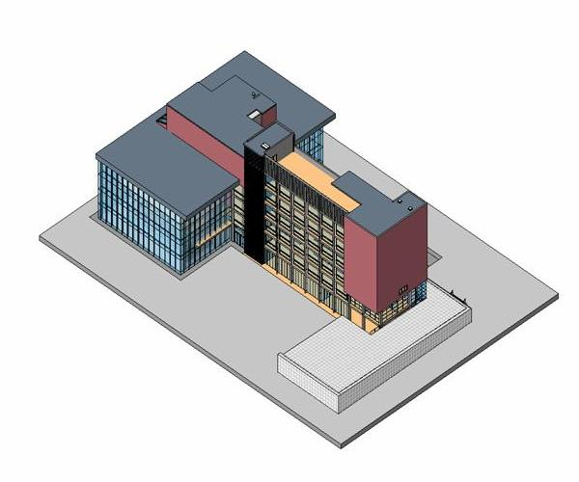
Layers of a Building
Notes:
Purpose: To introduce the idea of what a building is made of, by looking at the exterior and then looking underneath the building’s skin.
This slide shows a typical building from the outside. Windows and the exterior walls are all that are visible.
____________________
Verbatim Format
Here we have the skin of a building. This slide shows a typical building as we would normally see it - from the outside. What do you normally see when you look at a building? (Allow students to offer answers.) You might see windows, right? What else? The exterior wall material, like concrete or brick. Maybe you see siding on a house. All these things on the outside are important to give the building a certain look, just like how the skin gives us the look. But these exterior elements may or may not be structural. They may just be for looks or to keep the building waterproof, like in our tent example. When you look at a building as a structural engineer, you can start to think about what is on the inside, too.
____________________
Outline Format
I. Point out that the building’s exterior is only a part of the building.
A. Ask the students what they normally see when the look at a building (windows, architectural elements)
B. Explain that the exterior of a building may or may not be structural.

Slide 6
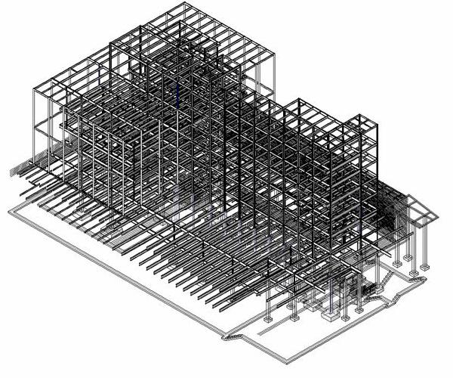
Layers of a Building
Notes:
Purpose: To introduce the idea of what structural elements lie inside the building’s exterior cover.
The speaker is to introduce the idea that the structural portions of buildings may not be visible in a finished building. They are often covered up by architectural elements. If the structural elements were exposed, we would be able to see columns, beams, structural walls and foundations.
____________________
Verbatim Format
This slide shows the same building as in the previous slide, except here the exterior façade has been removed to expose the structural elements underneath. What you can see now that you couldn’t before are the columns, beams, and foundations that hold the building up. A structural engineer would design the size and strength of these members.
____________________
Outline Format
I. Layer 2
A. Structural engineer
1.Designs the part of the building that makes it stand

Slide 7
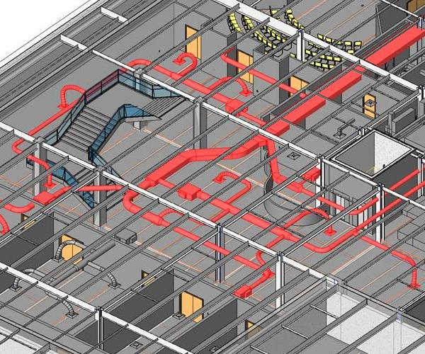
Layers of a Building
Notes:
Purpose: To explain to the students about the layers of the building that the architect and mechanical engineer are in charge of.
____________________
Verbatim Format
Now we see a close up of the interior of the same building. In this view, you can see things that you normally see when you walk around a building, like walls, doors, and seats. The architect designs all that. In this picture you can also see the ductwork for heating and air conditioning, shown in red, which the mechanical engineer designs. The mechanical part of the building is usually not seen in most buildings. The ducts are usually hidden in the floors, ceilings and walls.
In this room the vent for the heating and/or air conditioning is most likely located in the ceiling. That diffuser over there is part of it (Point to diffuser in the room if exists). When you see a vent like that in a ceiling, you can imagine that there are ducts just like the ones here in the picture running over your head in the ceiling above.
These ducts I am talking about are the ones that get so much attention in a movie where someone is trying to escape a room, and they take the grate off the vent and go crawling around in a duct until they are led to freedom. Not completely realistic, but it shows how the ducting system goes throughout entire buildings.
____________________
Outline Format
I. Layer 3
A. Architect
1. Wall layouts, door locations, stair locations, seating arrangement
B. Mechanical engineer
1. Heating and air conditioning flow

Slide 8
So you want to build a house?
Owner – buys the plot of land
Architect – designs the look of the house, coordinates the team from beginning to end
Structural Engineer – designs the frame, foundation
Contractor – builds the house
Notes:
Purpose: To provide a simple example of the roles of the building team, including owner, architect, contractor, and structural engineer.
The speaker is to explain to the audience what roles are typically involved in a building project by using a very simple camping tent model.
____________________
Verbatim Format
In the previous slides we have looked at different systems designed by different engineers in a building. Let’s take a look at some other roles or jobs involved in a building project.
Let’s say that you are going camping and you need to have a tent to sleep in. In this example, the first person involved is the person who has the campsite. That person is called the owner. The owner typically owns land and wants to have a building or other structure built on that land. The owner will then hire a team to design and build the structure. The owner will hire an architect to design the look of the structure. For our tent here, that could mean how big the tent is, what materials it will be made from, what color the canvas will be, and even where the door to get in will be. The architect also coordinates all the team members throughout the project. The structural engineer will either be hired by the owner or by the architect. The structural engineer’s job would be to design the poles that hold up the tent and the stakes that hold the tent down to the ground. The architect and structural engineer would work together to make drawings explaining how to build the tent they designed, kind of like the instruction manual that comes with a tent that you buy. The owner will then hire the contractor. The contractor’s job would be to use the drawings that the architect and structural engineer prepared to actually build the tent.
If we were building an entire building, we would use this same process with an owner, architect, engineer, and contractor. It could be any type of project, but it’s the same idea.
____________________
Outline Format
I. Define roles involved in a building project team
A. Owner
1. Owns the land the structure is to be built on – campsite
2. Hires the architect, contractor, and maybe engineers
B. Architect
1. Designs the look of the structure – size, color, shape
2. Coordinates the building team
3. May hire the engineers
C. Structural Engineer
1. Designs the structural parts of the building – poles, stakes
D. Contractor
1.Builds the structure (tent)

Slide 9
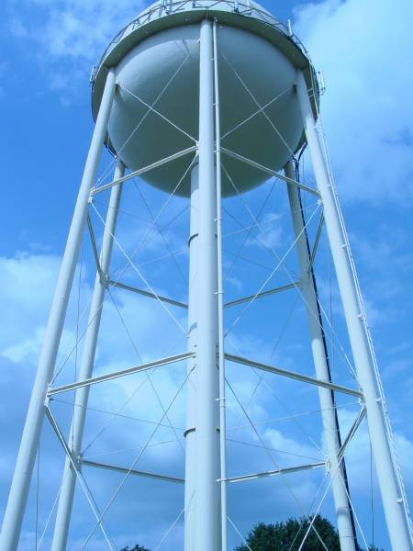
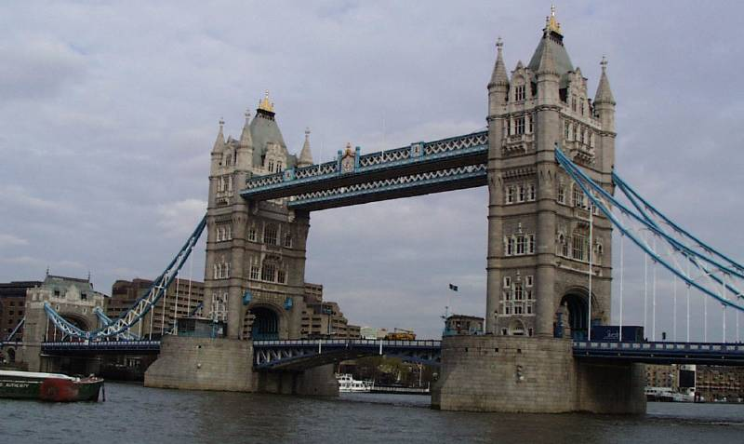
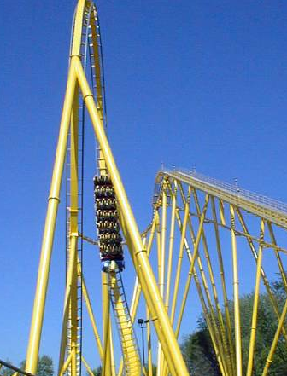
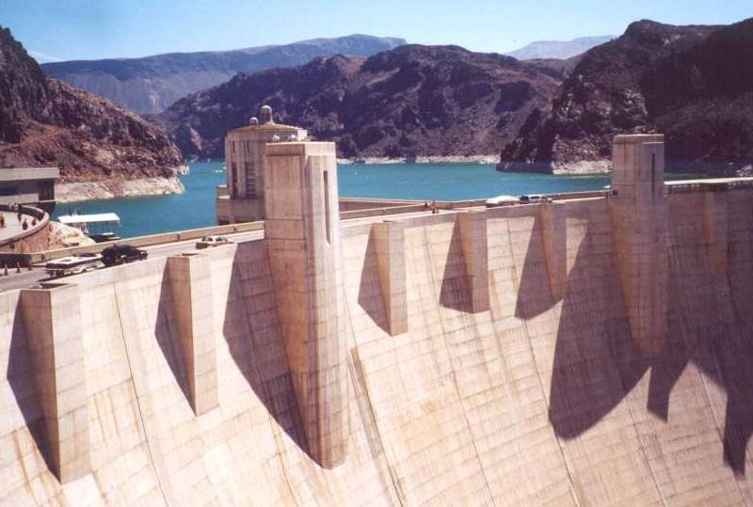
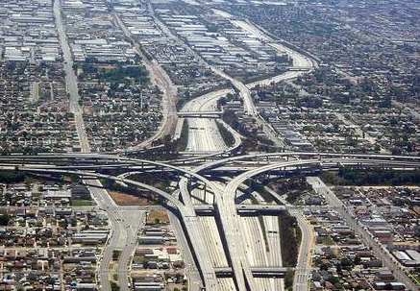
Types of Structures
Notes:
Purpose: To give examples of different types of structures that structural engineers design.
The speaker is to go over the six photos while mentioning how all of them require structural engineering. Photos: (top left, clockwise) water tower, bridge (Tower Bridge in London), skyscraper (Empire State), freeway interchange, roller coaster, dam (Hoover Dam). The speaker can then ask for some more examples, possibly adding some more of his/hers to get the discussion going.
____________________
Verbatim Format
Here are some of the projects structural engineers can work on. I’m assuming most of you have been on a roller coaster before, but probably didn’t think that it took a lot of engineering to make the cars run the way they do. Other examples…dams, water towers, freeway interchanges, skyscrapers and bridges. Can anyone think of any other examples of structures that require structural engineering?
____________________
Outline Format
I. Types of structures.
A. Water tower
B. Bridge
C. Skyscrapers
D. Freeways
E. Roller coaster
F. Dam

Slide 10
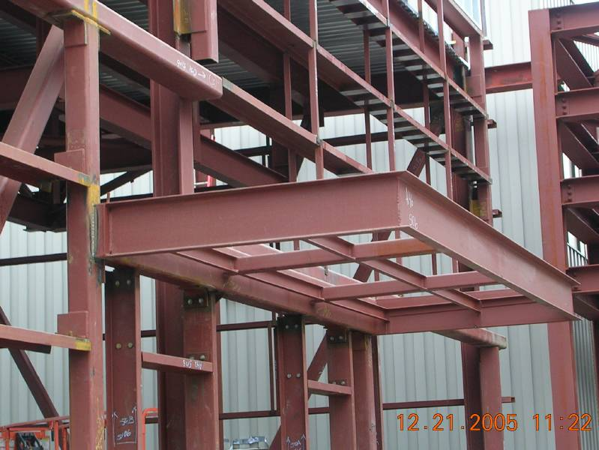
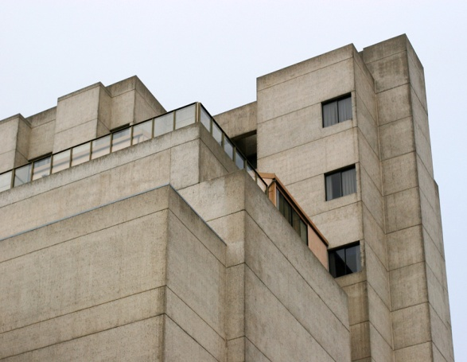
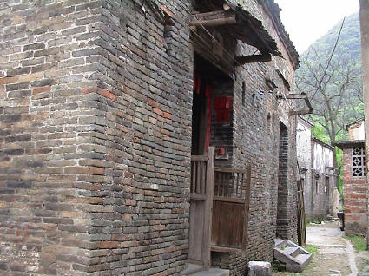
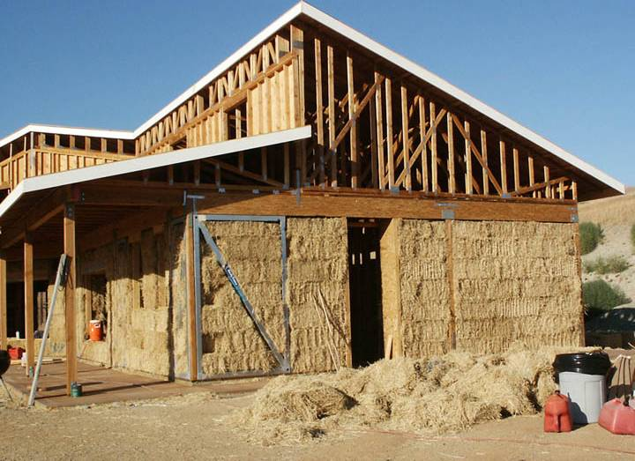
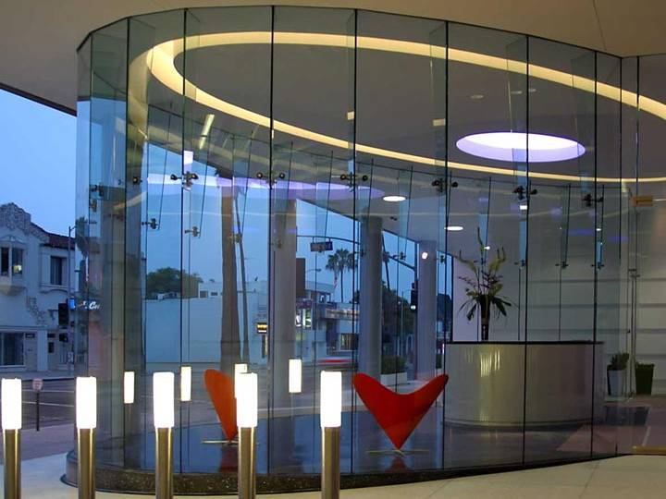
Structural Materials
Notes:
Purpose: To inform the audience about various construction materials used in structural design.
The speaker is to explain to the audience about the six major construction materials used in the design of most structures. The slide is intended to be an interactive exercise between the speaker and audience. The speaker is to ask the audience to identify the construction materials. When all the materials has been identified, the speaker should provide examples of when these materials are commonly found in design.
____________________
Verbatim
Engineers design the different types of structures we just looked at using various materials. Each material has different strengths and weaknesses, and are used more commonly in some structures than others. Can you guess some of the construction materials used in design (Let audience answer the question)? Good. It is common for engineers to design structures using steel, concrete, wood, and masonry. Glass and even ice and straw bales are used in some structures, but not as common as the other four. Of course, other materials are used but these are the primary materials.
Because each of these materials has different properties which make it act differently, there are common ways each material is used. For example, what are a lot of houses made of? (wood.) Wood is used for smaller structures like houses or smaller buildings. What about concrete? Where would you see concrete used? Today, concrete is typically used to design most bridges.. Concrete is also popular in the design of dams. Most designs of high rise buildings use a combination of concrete and steel.
____________________
Outline
Some materials are used for structural design.
A. Steel
B. Concrete
C. Masonry
D. Wood
E. Straw
F. Glass
G. Ice
II. These materials are found commonly in some types of structures.
A. Wood – houses, small buildings
B. Concrete – bridges, dams, high-rise buildings
C. Steel – bridges and high-rise buildings

Slide 11
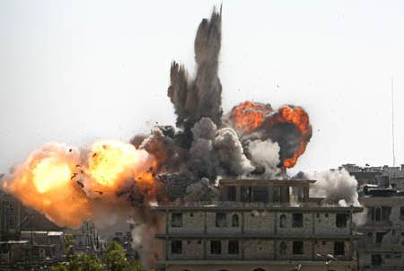
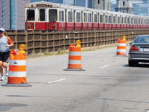
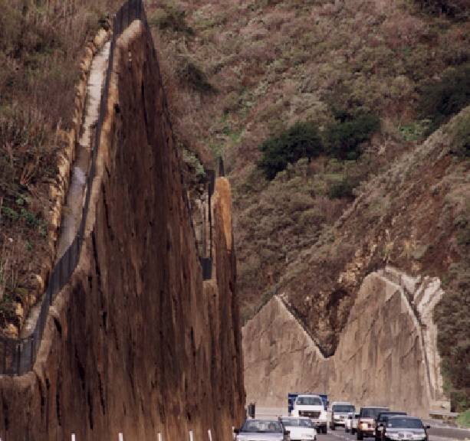
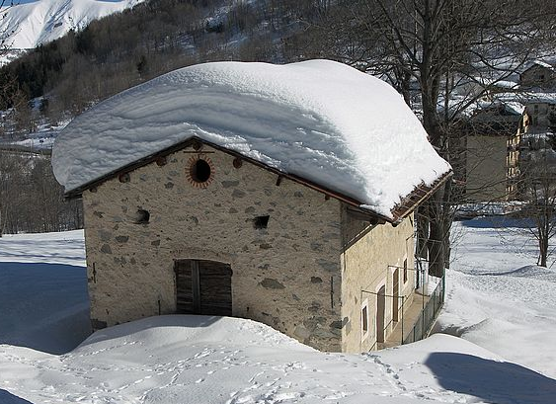
What Loads Do Buildings See?
Notes:
Purpose: To inform the audience about the common design loads.
The speaker is to identify the common design loads in structural engineering. Six design loads are illustrated in the slide. Top (left to right) represents seismic, wind, and blast loads. Bottom (left to right) represents gravity, soil, and hydraulic loads. The speaker should encourage class participation by asking the class to identify the different design loads. When all the loads have been identified, the speaker can briefly provide examples of structures designed to resist the discussed forces.
____________________
Verbatim
Now that we have looked at the types of structures and materials that structural engineers use, let’s look at what these structures are designed for. Structures are designed to resist many forces. Can anyone think of some forces used in structural engineering? If you lived in or around Boston, you can probably guess heavy snow and wind are common design loads. Other forces considered in structural designs are earthquake loads, water loads, earth loads, and blast loads. A structure must also be designed to supports its own weight and the weight placed on it, such as a truck on a bridge.
The common design loads are considered in the design of many structures. Dams are designed to resist water loads. Retaining walls are designed to hold back soil. Bridges are designed for wind and seismic forces. Important buildings, such as foreign U.S. embassies, federal government buildings, and military buildings are designed to resist blast loads. Can anyone give more examples?
____________________
Outline
I. Structural design typically involves six common design loads.
A. Seismic forces
B. Wind loads
C. Blast loads
D. Gravity loads
E. Soil pressure
F. Water pressure
II. There are many structures designed to resist these forces.
A. Most long-span bridges are designed for wind, seismic, and gravity loads
B. Retaining walls designed to resist earth pressures
C. Dams resist hydraulic pressures
D. Government buildings, such as embassies, are designed for blast loads

Slide 12
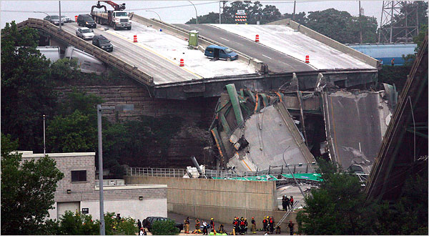
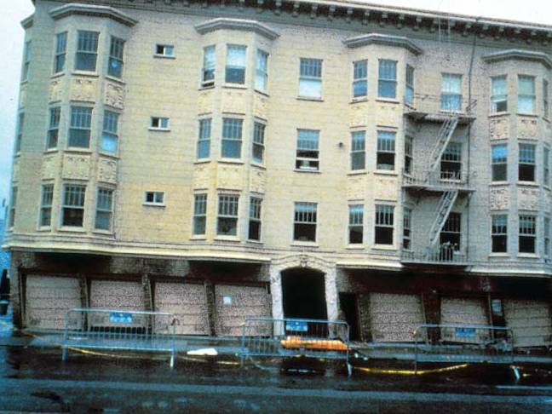
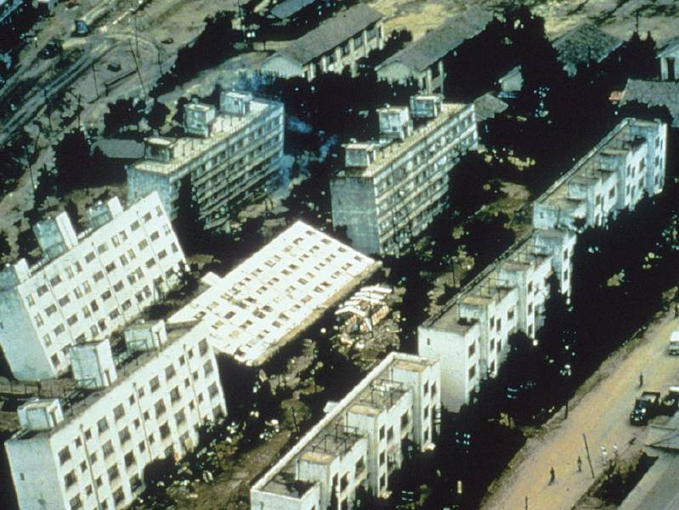
What If Loads Are Too Large?
Notes:
Purpose: To explain to the audience that if structures are not properly designed, disasters can happen, and people can get hurt.
The slide is a follow-up to the previous slide. In the previous slide, the different loading conditions are explained. This slide shows what would happen to buildings if the loading conditions are not estimated or designed properly.
____________________
Verbatim Format
What if loads are too large? Buildings can collapse under many different circumstances. The lower left picture shows what happen to buildings after the Kobe earthquake in Japan. The soil supporting the buildings liquefied (become quick sand) and the buildings sank to the ground and tilted over. The upper left picture shows what happened to the I-35 highway bridge at the Mississippi River crossing in Minneapolis in 2007. The bridge was overloaded during rehabilitation preparation activities. The bridge collapsed, causing major traffic problems for months. The upper right picture shows an apartment building in the Marina district of San Francisco after an earthquake. The first story, because of the many garage door openings, is weaker than the stories above. The first story was strong enough so that the upper stories drifted to one side. The lower right picture shows what happened to a building after the Katrina hurricane. The roof was not strong enough to withstand wind forces, so it was blown away.
____________________
Outline Format
I. Buildings can collapse as a result of different types of loading
A. Picture 1 (Upper left – 2007 Rehabilitation Construction) – Caused by overloading as a result of pre- construction activities
B. Picture 2 (Upper right – 1989 Loma Prieta Earthquake) – Caused by soft story as a result of large openings at garages
C. Picture 3 (Lower left – Kobe Earthquake) – Foundation failure as a result of liquefaction (Building above g round stays intact but tilts)
D. Picture 4 (Lower right – 2005 Katrina) – Roof

Slide 13
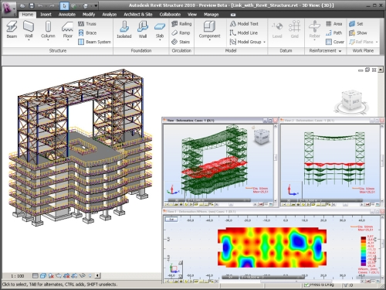
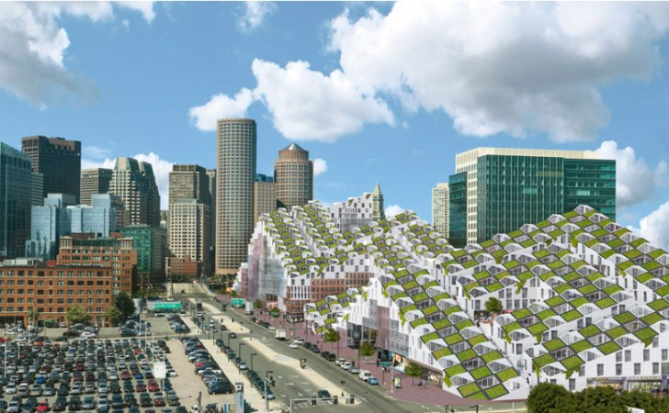
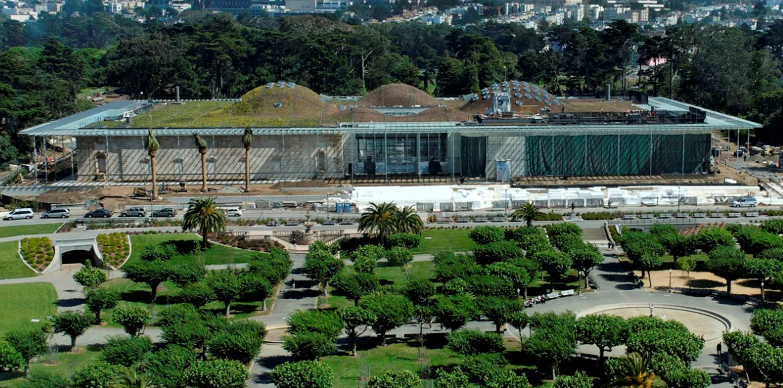
Future Trends
Notes:
Purpose: To illustrate some of the trends and challenges that the structural engineers will be facing in the future.
This slide is intended for a more mature audience who is more serious about choosing structural engineering as his or her major. This slide discusses the future trends and challenges that structural engineers will face. They include the use of BIM (Building Information Modeling) technology, and Sustainability Design (“green” design).
____________________
Verbatim Format
What is the future like for structural engineers? If you do decide to go into structural engineering, here are some trends that are expected to gain popularity. By the time you finish school and become a practicing engineer, these issues are most likely to be affecting your day-to-day job.
The use of BIM (Building Information Technology) is becoming more and more popular. BIM technology usually refers to one single model (usually 3-dimensional) such that architects, engineers, contractors, etc. will share information contained in the same model. It is a smart model because when you model a beam, for example, the program knows all the properties that are associated with that beam. Therefore, the model no longer only shows lines depicting the beam, but it knows all properties including dimensions, strength, material type, etc.
With the current awareness of global warming, sustainable design is going to be important for the next few decades to come. Constructing a building requires a lot of materials, and if the materials are not carefully chosen, it could lead to a lot of waste. Even if you are not aware of it, buildings use electricity and need air conditioning to make the occupants comfortable. Architects and engineers nowadays are coming up with designs such that the use of energy is minimized. Some buildings would have solar panels installed on the roof. Some buildings may use natural ventilation so that no air-conditioning will be required. The list goes on and on.
____________________
Outline Format
I. Future Trends of structural engineering
A. Picture 1 (Upper right – Seaport Revitalization) – Buildings that that incorporate sustainable design elements such as roof gardens, rain-water catchment, proximity to public transportation, and balcony/sunlight offsets and dense urban design.
B. Picture 2 (Upper left – BIM model) – 3-D model such that architects, engineers, owners, and contractors share information
C. Picture 3 (Lower right – Solar panels on roof) – Installation of solar panels will minimize the use of energy in the building, thus minimizing the production of greenhouse gases.
D. Picture 4 (Lower left –San Francisco Academy of Sciences Building) – Uses natural ventilation, roof garden, and other sustainable building design features. Largest green roof in the nation.

Slide 14
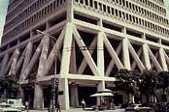
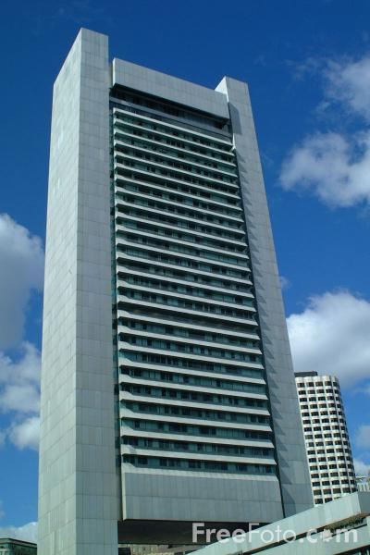
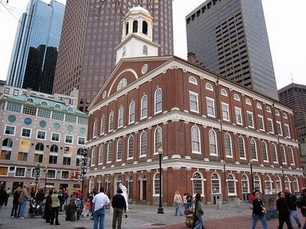
Strong and Stable
Notes:
Purpose: To inform the audience about different types of lateral resisting systems that are required.
The speaker is to explain to the audience about the types of lateral resisting systems that are commonly used. The pictures…Left: steel braced frame structure. Top middle: space truss system. Bottom middle: brick masonry shear walls. Right: Concrete shear walls. This slide is more of an informative slide as opposed to an interactive one. Most likely the students will not know these systems, although they may recognize them.
____________________
Verbatim Format
The failure of structures caused by instability due to wind loading is something we are very concerned with. We live in an area that has the potential to be in the path of a Category 3 hurricane. When designing structures in New England engineers must not only design for gravity and snow loads but also for high wind loads; loads that act in the lateral direction…left to right. The first photo is of a 400 ft tall building in downtown San Francisco. The braces, the diagonal members you see on the building face, help the building resist sideway forces, like the kind you get from an earthquake or big wind storm. They stiffen up the structure and without them, any decent sized earthquake could cause this building to fail. The top middle photo of the Transamerica building, has a similar system to the braced frames. This system is called a space truss. The last two photos are of structures with shear walls, brick masonry and steel cladded concrete.
____________________
Outline Format
I. Different lateral systems.
A. Brace frames
B. Shear walls
C. Moment frames

Slide 15
Structural Engineering Tools
Notes:
Purpose: Illustrate exciting aspects of structural engineering.
The speaker is to illustrate the two common tools used in structural engineering. The first item involves the use of computer simulations to predict structural response. The second item involves the use of experimental tests to study structural behavior. The speaker is encouraged to provide their personal experience with these engineering tools, if applicable.
____________________
Verbatim
Since disasters are hard to predict, computer modeling and experimental tests are some tools used in structural engineering to help us understand what happens to a structure when a large scale event happens, like a hurricane. A structural engineer uses computer models to predict the response of a structure under different loadings (such as the forces describe in the design criteria slide). Earthquakes can be incorporated in the computer models to illustrate how a structure will react under the given seismic event. Results from these computer models are then used to design the real structure. This particular model was created on a commonly used structural engineering program called SAP2000.
Besides testing structures in computer models, structural engineers can perform experiments. Shake tables, which are platforms that can move, simulate ground movement as a result of an earthquake in order to test full size structures. These tests are not only fun to watch, but have provided invaluable information for designing earthquake resistant structures. For instance, the two-story house shown on the right slide is placed on top of a shake table. Information from this test will help engineers identify the strengths and weakness of the walls panels and overall structural response during an earthquake. Explosions, to study impact forces on structures, have also been simulated in structural engineering labs. These are just some aspects of the field that makes structural engineering a fun career.
____________________
Outline
Structural engineers use computer models to predict forces and responses on a structure.
A. Computer model can predict response of structure due to wind, seismic, and other forces.
B. Results of computer analysis are used to design the structure.
C. Model shown on slide is from a common structural engineering modeling program (SAP2000).
II. Experimental tests are performed to develop a better understanding of structural engineering behavior.
A. Structures are tested on shake tables to study effects of earthquakes.
1. Featured slide shows a full scale model on a shake table. This test was performed to quantify the contribution of the wall panels to the overall structural response during an earthquake.
B. Other experimental tests, such as blast mitigation experiments, or wind tests, study the effects of impact on structures.

Slide 16
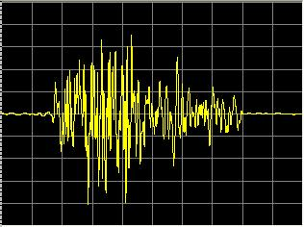
Notes:
Base isolated building ETABS ground motion

Slide 17
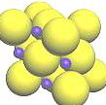
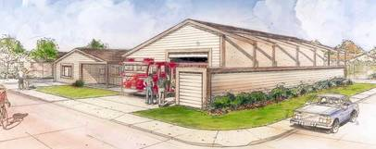
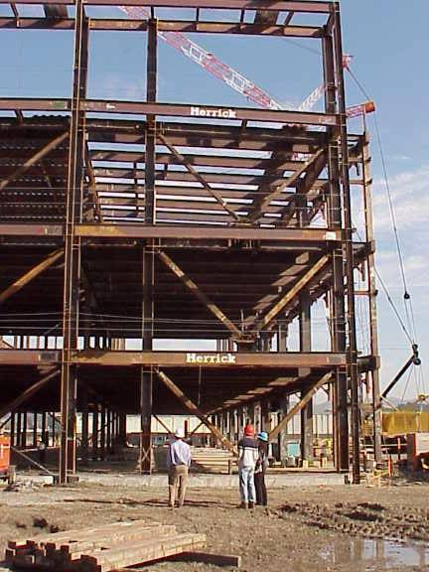
Are You Interested In…?
science
math
computers
drawing
construction
problem solving
Notes:
Purpose: To explain to the audience how they can tell if they might like to pursue engineering as a major or career
Middle school and high school students like to know whether pursuing engineering as a major or career is right for them. The speaker will inform the audience that there are signs that will allow the students to guess whether they will like engineering. If they are interested in the above subject matters, then engineering may be right for them.
____________________
Verbatim Format
Do you think you have what it takes to be an engineer? Becoming an engineer takes many years of school work and experience. Do you think engineering right for you? Think about it for yourself and reflect on what naturally draws your attention. What are your favorite classes in school? If you enjoy studying math, science, doing the homework problems, or if you enjoy working with computers, enjoy drawing, or if you like to stare at bridges or buildings under construction when you drive by it, there is a good chance that you will like engineering (or civil engineering) as a career.
____________________
Outline Format
I. Interests necessary to enjoy pursuing civil engineering
A. Math
B. Science – may be physics
C. Drawings
D. Use of computers
E. Problem solving – working on math or science problems
F. Like to see things being built

Slide 18
Interested In Structural Engineering?
Take Math, Science, Computer, and Drafting Classes, Research Career
High School
Major in Civil Engineering, Competitions, Professional Organizations
College
Major in Structural Engineering, Internships, Competitions, Research, Professional Organizations
Graduate School (recommended)
Notes:
Purpose: To inform the audience about what they should study or classes they should take in school.
The slide is primarily targeted to high school students because middle school curriculum is usually set and has very little flexibility. The speaker may choose to either delete this slide or talk about it briefly when presenting to younger audience.
____________________
Verbatim Format
How do you become a structural engineer? What classes should you take? If you are in high school, I suggest taking as many advanced math or science classes as you can. Engineering is based on a strong fundamental understanding of mathematic principles and scientific concepts. You will benefit quite a bit if your school offers art, drafting, or architecture classes.
In college, you may want to consider majoring in civil engineering. Some schools offer a similar major called architectural engineering in which the focus is entirely on buildings and structures. Almost every university will have student engineering organizations that you can be a part of. These are student-led professional organizations that help sponsor engineering talks and seminars, career fairs, and student competitions such as concrete canoe competition or steel bridge competition. Take advantage of those. Not only will you get a better understanding of engineering, you will also meet a lot of people and make your college experience a lot more memorable.
It is quite common for civil engineering majors to pursue a graduate (masters) degree before working. It is actually highly recommended in the industry now. You may want to concentrate on graduate structural engineering programs. In graduate schools, you will have the opportunity to join graduate-level professional organizations and work with professors on research projects that interest you.
____________________
Outline Format
I. How to prepare to be an engineer?
A. High School – Take Classes in advanced math, science, art, architecture, drafting, computer
B. College – Major in Civil Engineering or Architectural Engineering, join professional organizations
C. Graduate School – Major in Structural Engineering, do research, try job internships

Slide 19
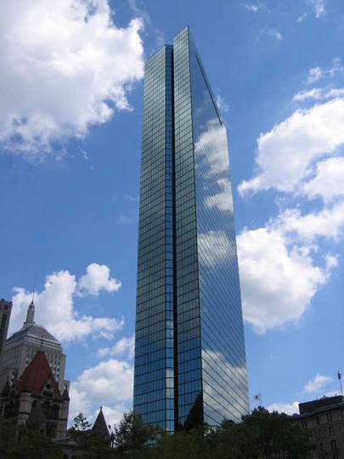
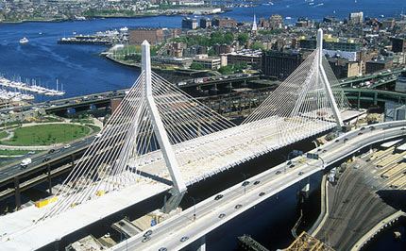
Rewards
See your work being built
Help people – safe environment
Learn stuff
Get paid
Notes:
Purpose: To identify some of the rewards of being a structural engineer
____________________
Verbatim
So what are the rewards for being a structural engineer? I think one of the coolest things is that you are able to see your work built. As a structural engineer, after you design the structure, you get to watch it being built, and you get to say, ‘I designed that building that all those people are using’. So you get to make your mark on the physical world that everyone lives in and uses. I’m sure most of you recognize the pictures on the bottom here. What’s the picture on the left? (Zakim Bridge Downtown Boston). And on the right? (The Hancock Tower in Copley Square)
And you get to help people by making the structures safe. As a structural engineer, you are making sure that whoever is using your building is not going to be harmed if there is a hurricane. For example, if a hurricane hit during a Boston Celtics game, the building keeps the people safe. Even the lights that are hanging are designed not to fall on somebody and hurt them.
You also get to learn a lot - you learn about the different construction materials we talked about, like steel and concrete and wood. You get to learn about how buildings are built by working with the contractors. You get to learn how to work with people by working in the design team with the architect and other engineers like we talked about in the beginning.
And, you get paid. That’s the question everyone wants the answer to, right? The average starting salary for someone graduating with a Bachelor of Science degree in 2010 was $58,000 per year. With a master’s degree, which is highly recommended, the starting salary in 2010 was $65,000 per year.
____________________
Outline
There are rewards to being a structural engineer.
A. See your work built - make an impact on the built environment
B. Help people – keep the built environment safe
C. Learn stuff
D. Get paid – provide average starting salaries of BS and MS
E. Other rewards?

Slide 20
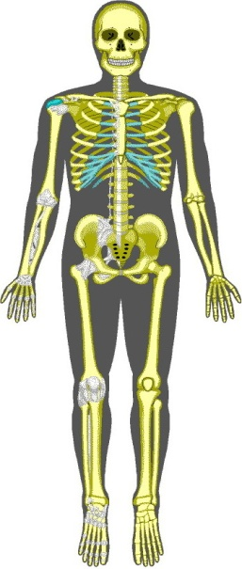
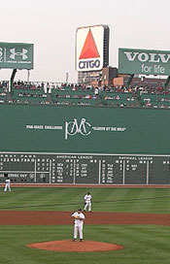
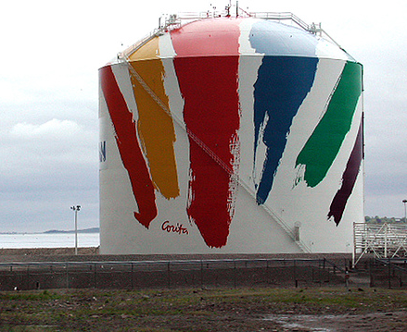
Questions?
Notes:
Purpose: To provide an opportunity for the audience to ask questions.
____________________
Verbatim
Does anyone have any questions?

